Slide 1
AZURE SYNAPSE - SPARK TWITTER EUROVISION ANALYSIS
ANISH DIXIT, AKSHIT MIGLANI, ANANYA BAJAJ, AMEYA BHAMARE

Slide 2
System Summary
Azure Synapse Analytics is a powerful cloud-based analytics service that combines enterprise data warehousing, big data processing, and data integration into a single unified platform. It seamlessly integrates with Apache Spark, a fast and flexible open-source analytics engine, to enable large-scale data processing and analytics capabilities.

Slide 3
Features & Capabilities
Feature | Description
Apache Spark Delta Lake tables in serverless SQL pools | The ability to for serverless SQL pools to access Delta Lake tables created in Spark databases is in preview.
Apache Spark elastic pool storage | Azure Synapse Analytics Spark pools now support elastic pool storage in preview. Elastic pool storage allows the Spark engine to monitor worker node temporary storage and attach more disks if needed.
Apache Spark Optimized Write | Optimize Write is a Delta Lake on Azure Synapse feature reduces the number of files written by Apache Spark 3 (3.1 and 3.2) and aims to increase individual file size of the written data.

Slide 4
Features & Capabilities - 2
Feature | Description
Apache Spark R language support | Built-in R support for Apache Spark is now in preview.
Azure Synapse Data Explorer | The Azure Synapse Data Explorer provides an interactive query experience to unlock insights from log and telemetry data. Connectors for Azure Data Explorer are available for Synapse Data Explorer.
Browse ADLS Gen2 folders in the Azure Synapse Analytics workspace | You can now browse an Azure Data Lake Storage Gen2 (ADLS Gen2) container or folder in your Azure Synapse Analytics workspace in Synapse Studio.

Slide 5
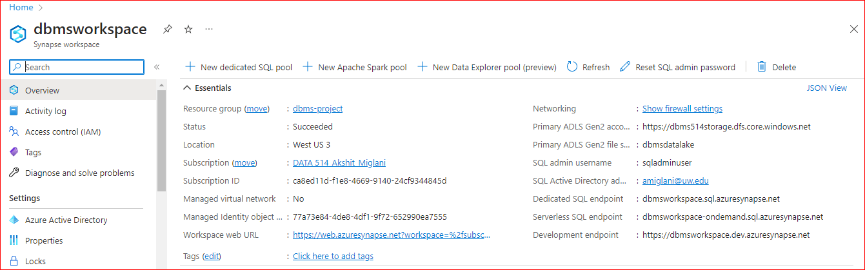
Setup Spark Cluster in Azure
Step 1: Create an Azure Synapse workspace
The first step is to create an Azure Synapse workspace in the Azure portal. This workspace is a unified workspace that allows us to manage our big data processing and analytics tasks. A Synapse workspace is a securable collaboration boundary for doing cloud-based enterprise analytics in Azure. A workspace is deployed in a specific region(in our case West) and has an associated ADLS Gen2 account and file system (for storing data). A workspace is under a resource group. A workspace allows us to perform analytics with SQL and Apache spark. Resources available for SQL and Spark analytics are organized into SQL and Spark pools. We also have Linked services to allow external data access: A workspace can contain any number of Linked service, essentially connection strings that define the connection information needed for the workspace to connect to external resources.

Slide 6
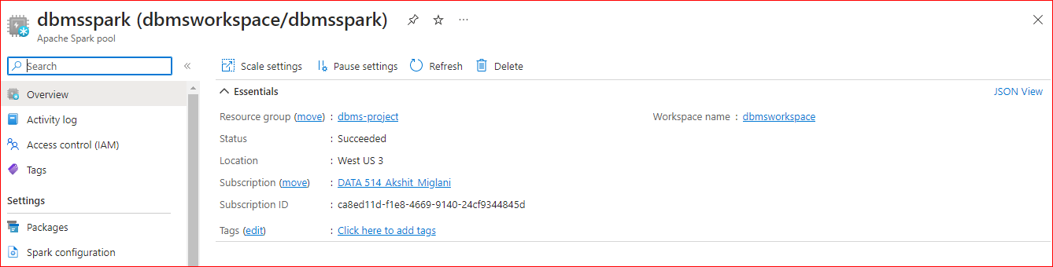
Setup Spark Cluster in Azure
Step 2: Create a Spark pool
Once our workspace is created, we created a Spark pool. A Spark pool is a set of resources that we can use to run Spark jobs. It is a set of metadata that defines the compute resource requirements and associated behavior characteristics when a Spark instance is instantiated. These characteristics include but aren't limited to name, number of nodes, node size, scaling behavior, and time to live.

Slide 7
Setup Spark Cluster in Azure
Step 3: Node Setup
Nodes: Apache Spark pool instance consists of one head node and two or more worker nodes with a minimum of three nodes in a Spark instance. The head node runs extra management services such as Livy, Yarn Resource Manager, Zookeeper, and the Spark driver. All nodes run services such as Node Agent and Yarn Node Manager. All worker nodes run the Spark Executor service.
Node Sizes: A Spark pool can be defined with node sizes that range from a Small compute node with 4 vCore and 32 GB of memory up to a XXLarge compute node with 64 vCore and 512 GB of memory per node. Node sizes can be altered after pool creation although the instance may need to be restarted.
Autoscale: Autoscale for Apache Spark pools allows automatic scale up and down of compute resources based on the amount of activity. When the autoscale feature is enabled, we set the minimum, and maximum number of nodes to scale(we did 3 - 16). When the autoscale feature is disabled, the number of nodes set will remain fixed.

Slide 8
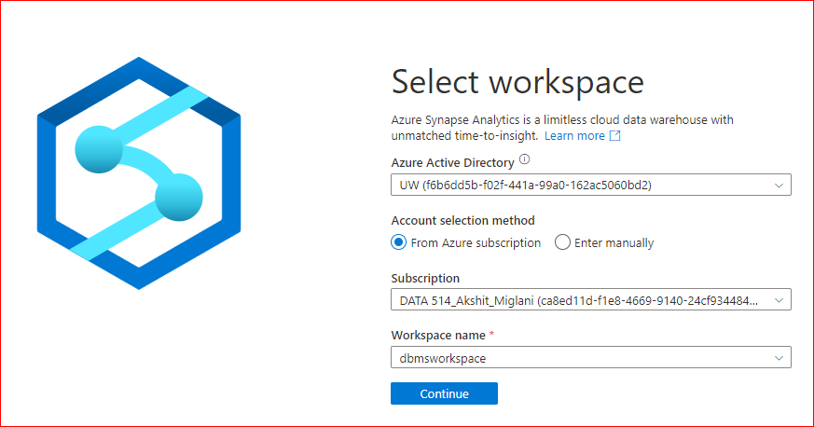
Setup Spark Cluster in Azure
Step 4: Storage Account and Connecting Azure Resources to Synapse
To analyze data using Spark, we created a storage account. On a storage account, we can upload data from a variety of sources, such as Azure Blob Storage, Azure Data Lake Storage, or on-premises data sources. Once we uploaded the data, we used it in our Spark jobs by connecting the Azure workspace to Synapse Analytics platform. We’re running our data system on two pillars: Azure resources such as workspace, data storage and Synapse Analytics platform. To leverage the capabilities of Synapse analytics platform by spinning up a spark pool using a notebook, we need the Azure resources on demand in the workspace interface. We do that by connecting the entire workspace to Synapse Analytics.

Slide 9
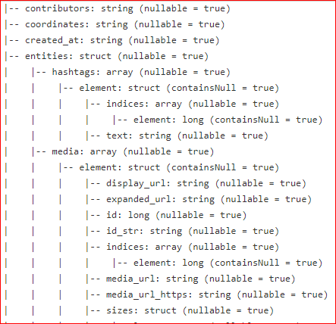
Load Twitter Data into Spark
Step 1: Our data is a nested JSON which we will need to convert to CSV in order to create Spark DataFrame easily.. JSON is a popular data format used for exchanging information between systems. It organizes data in a hierarchical structure, making it suitable for representing complex objects. Nested JSON structures contain objects or arrays within other objects or arrays, posing a challenge when working with such data in Spark.

Slide 10
Load Twitter Data into Spark
Step 2: Convert nested JSON to Spark DataFrame using Python Pre-Processing
Parsing the Nested JSON: To work with the nested JSON data, we use the from_json function. This function parses the JSON column and converts it into a struct type, preserving the nested structure. We specify the schema of the JSON data to ensure correct parsing.
Exploding Arrays: If the JSON contains arrays, we might need to expand them to process individual elements. Spark's explode function allows us to unnest arrays, creating multiple rows for each array element. This step helps to flatten the nested structure and enables easy access to individual array elements.
Extracting Nested Fields: Once the JSON data is parsed and arrays are exploded, we can access nested fields using dot notation. By specifying the path to the desired field, we can extract and create new columns for further analysis or transformations.
Performing Operations: With the flattened DataFrame, we can perform various operations like filtering, aggregating, or joining with other data sources. Spark provides a rich set of functions and SQL-like expressions to manipulate and transform the data efficiently.

Slide 11
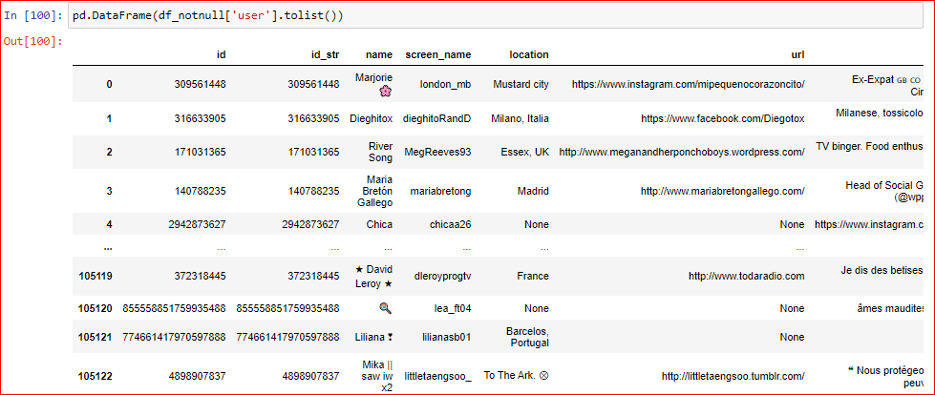
Load Twitter Data into Spark
Result:
We get a flattened DataFrame considering unique values per row for columns of interest. We can use the SQL expression in the spark notebook to do the analysis.

Slide 12
QUERYING TWITTER EUROVISION DATA IN SPARK

Slide 13
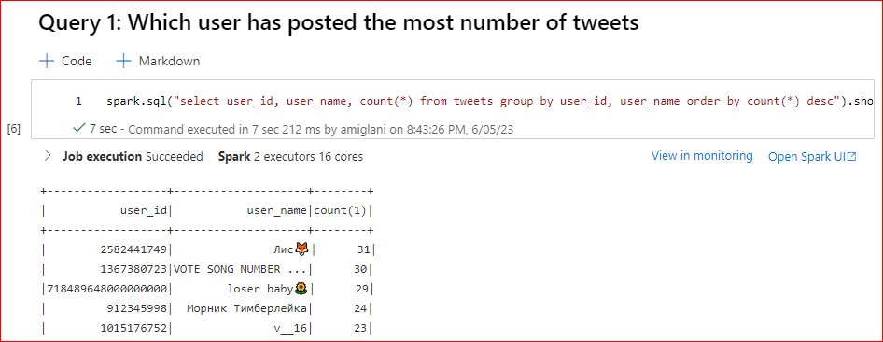

Slide 14
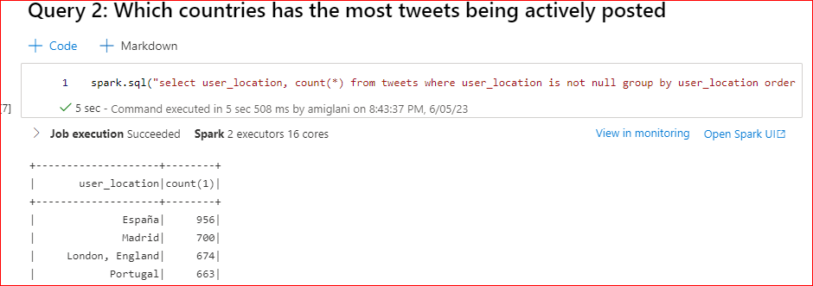

Slide 15
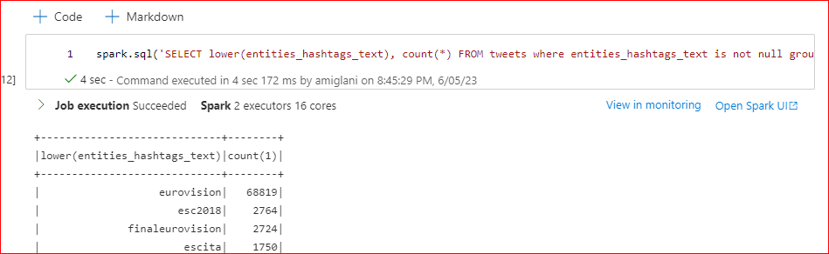
QUERY 3: How many tweets are associated with each hashtag?

Slide 16
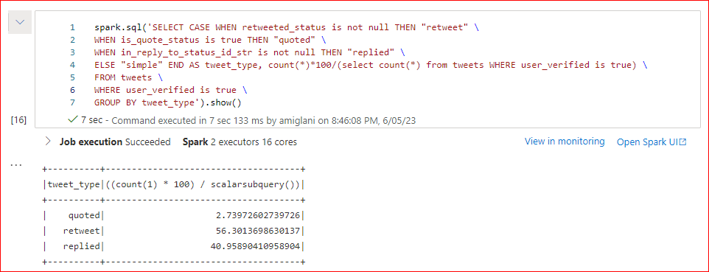
QUERY 4: For each verified user, what is the percentage of different types of tweets (simple tweet, reply, retweet, quoted tweet) to their overall number of tweets?

Slide 17
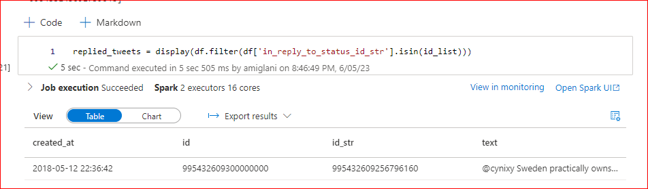
QUERY 5: Display the thread (replies) of tweets (the tweet, time, id, in reply to id, user name with their screen name) posted by user with screen_name “blcklcfr” in the order in which they were posted.

Slide 18
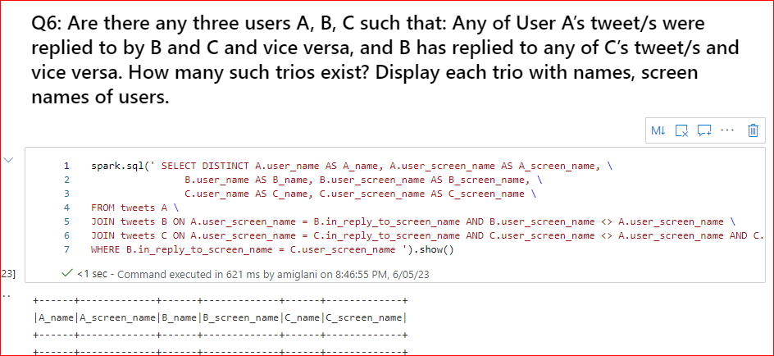

Slide 19
THANK YOU!

